Slide 1
All Virtual
Why virtual

Slide 2
What is Virtual?
In computing, the term virtual refers to a digitally replicated version of something real, whether it's a machine, a switch, memory or even reality. It is distinguished from the real by the fact that it lacks an absolute, physical form. However, functionally it is no less real.

Slide 3
Virtual memory. It refers to a nonphysical set of memory addresses or locations that are treated as physical memory when a program or application is executed. It allows a computer to compensate for physical memory shortages by temporarily transferring data from the device RAM to disk storage.
Virtual assistant. A virtual assistant is a program or device that understands human languages to some extent, and performs tasks based on the spoken requests or requirements. Amazon's Alexa and Apple's Siri are examples of popular virtual assistants.
Virtual agent. A virtual agent is an automated chatbot or voicebot that provides customer service without the need for human intervention.
Virtual machine (VM). A VM is an OS or application environment that displays the characteristics of dedicated hardware in a virtual environment.
Virtual switch. A virtual switch is a software program that manages network traffic and allows communication between VMs.
Virtual tape. A virtual tape is a storage technology application that makes a drive-based storage system look like a tape library.
Virtual world. A virtual world is a simulated, computer-based environment where users can create personal avatars, participate in virtual activities and communicate with other users over the internet through voice or chat.
Virtual Reality (VR). VR is an artificial environment that offers immersive audio and visual experiences to users. These experiences are usually presented through specialized equipment. While the experience is fairly realistic, the users' physical reality does not exhibit any change.

Slide 4
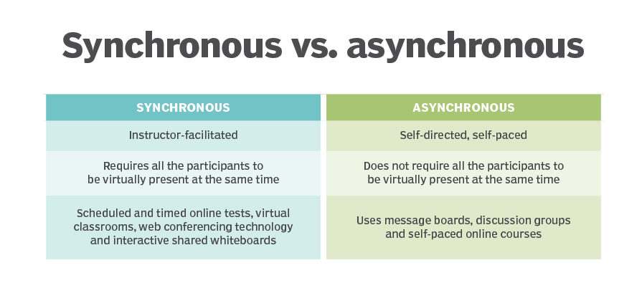

Slide 5
